Slide 1
System and performance analysis
A brief recap
Paul Sayers
With Wouter (at home)
Presentation FAIR, Hamar, Norway
Contact: paul.sayers@sayersandpartners.co.uk
Notes:
1

Slide 2
Source-Pathway-Receptor
The framework helps in three ways:
I: Helps understand the issues that influence risks and the risk metrics to be considered (and hence of the scope of the issues to be considered)
2: Helps understand the way in which sources are translated through a series of processes to impact a receptor (e.g. a person, property)
3: Informs the performance analysis and what needs to be analysed and why

Slide 3
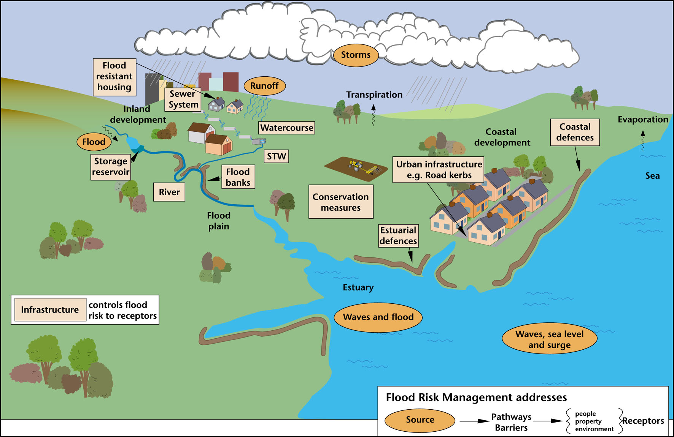
I: Helping understand the issues that influence risk….
Bramley and Sayers, 2004
Notes:
Money and time are limited - driving the need to
Multiple rivers and drainage networks
Multiple driving sources – waves, surge, flow
Over 7000 individual defences, gates and barriers

Slide 4
I: Helping understand issues that influence risk and the risk metrics to be considered

Slide 5
II: Helps understand the way in which sources are translated through a series of processes to impact a receptor (e.g. a person, property)
Risk metrics
Sayers et al, 2002

Slide 6
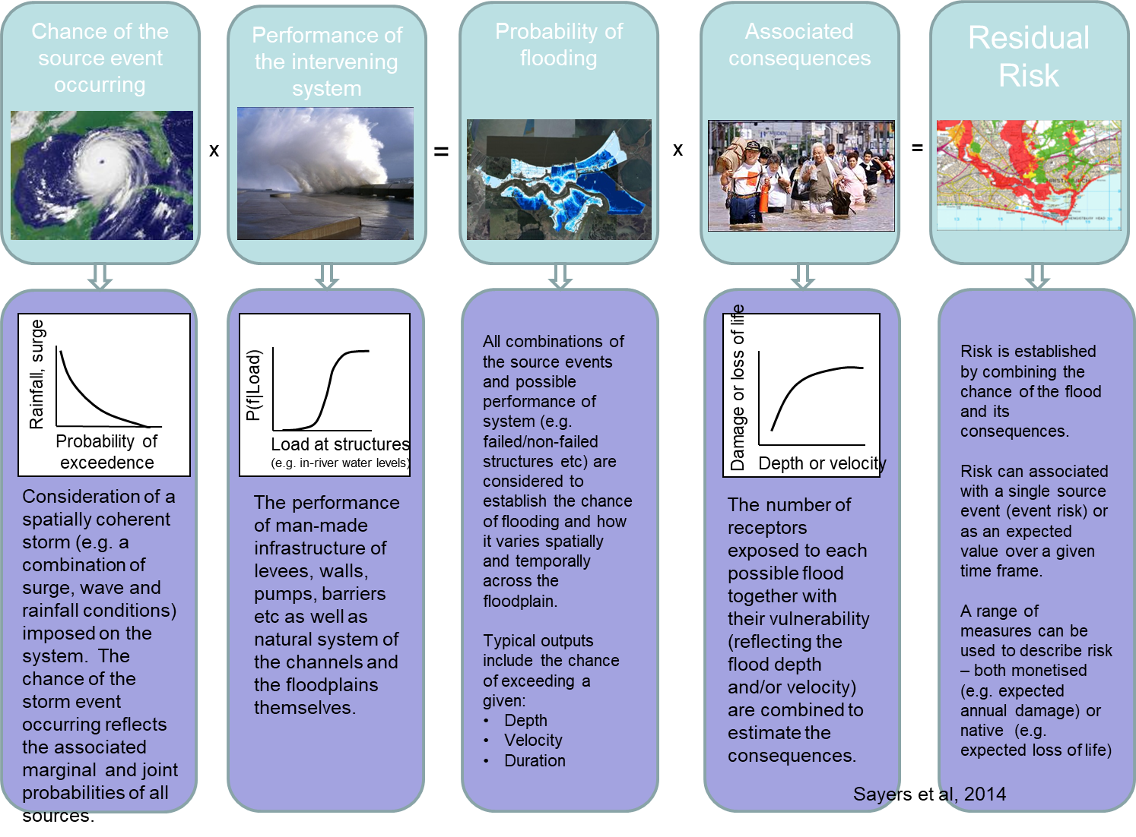
III: Informs the performance analysis and what needs to be analysed and why
Notes:
[Click] For the purpose of this model, RISK is an index of possible life and property loss that was caused by flooding from a tropical storm or hurricane
[Click] RISK equals the odds of a tropical storm or hurricane hitting the New Orleans area
[Click] TIMES the strength and reliability of the protection system against that storm’s surge
[Click] TIMES the potential loss of life and property in the event of overtopping, breaching, rainfall, etc.
The risk and reliability model analyzes the protection system against possible hazards to understand and quantify risk so that it can be managed.
Now…let’s look at each of these a little more closely…[Click] CHANCE of HAZARD: While figuring out that not all hurricanes are the same, the scientists also realized that the old way of looking at past hurricanes to build a levee system was not the right way to do things.
Using all of the information they knew about hurricanes they used computers to create additional storms that we could possibly see here in the future - they modeled 152 storms from small hurricanes to extremely large ones. They modeled hurricanes that ranged from ones most people would consider common annual events, to ones of biblical proportions, as well as their likelihood of hitting the New Orleans area.
To put this in perspective, This is more than twice the number (68) of hurricanes that made landfall along the Louisiana, Mississippi and Alabama coastlines since 1851. As a reference, there have been 279 hurricanes in the continental United States from 1851 – 2006.
[Click] SYSTEM PERFORMANCE: IPET studied the entire 350-mile system; every span of levees, and every feature, meaning floodgates, walls, etc. They looked at it from two perspectives:
- What was the state of the protection system pre-Katrina, and what is it today.
The Army Corps of Engineers did the work on the 100-year designs to forecast future risk.
[Click] And finally CONSEQUENCES: This data was based on Pre-Katrina population and property information so the comparisons in terms of overall risk could be compared.
ARE THERE ANY QUESTIONS ON THIS SLIDE? It is critical that we explain this clearly to you before we move on.

Slide 7
Source
That part which is enforced on the system that can be considered external (not influenced by) to the system of interest
Note that the definition of sources will different – and can be chosen by you – as the loads on the system
This may require joint probability analysis (waves and water levels – and transformation to the boundaries of ‘your’ system

Slide 8
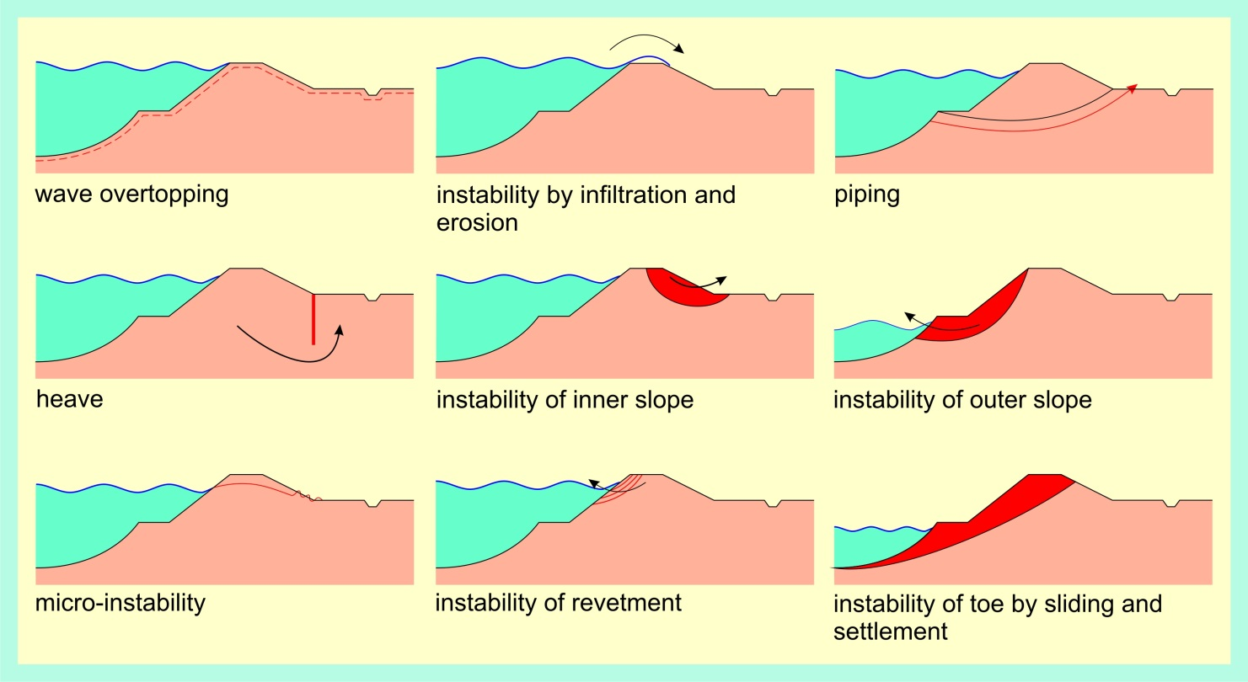
Pathways
Everything that influences the flood of water between the source and the receptor
Dikes, quay walls, higher grounds, storm surge barriers, dams etc etc.
Multiple failure mechanisms

Slide 9
Pathway – Individual asset performance
We evaluate a limit state function
Z = R-S
  Z < 0 means failure, R = Strength, S = Load
Can be simple or more complex
  Simple: Fail occurs at overflow of a dike: Z = crest level – water level
  More complex: Multiple interacting failure modes – rear face erosion, piping, rotating, micro fissures etc

Slide 10
Pathways – Evaluation approaches
“Simple” rules
  “Crest height should be 1 meter above highest recorded water level”
  “ok/not ok”
Based on design water levels
  “We want the crest height to be a given allowance above the 1/100 year water level”
  “ok/not ok”
Semi-probabilistic approach (using design water levels)
  A focus on a design event and the failure given that event
  Examples: Dutch assessment rules
Probabilistic analysis
  Fragility curves (as in the UK) – consider the chance of failure across all loads.

Slide 11
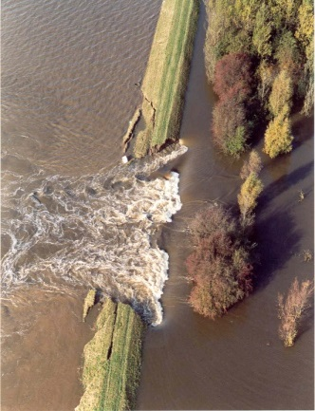
Fragility curve – conventional mis-interpretation
(Sayers et al, 2004)

Slide 12
Fragility curve – a more realistic interpretation

Slide 13
Accounting of different condition
High level fragility curve - sloping embankments
(Sayers et al, 2004)

Slide 14
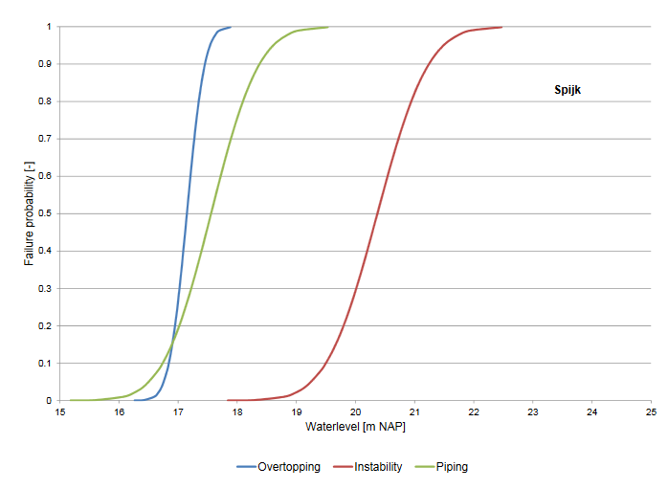
Fragility curves (by failure mode) – Netherlands, Wouter

Slide 15
Application in FAIR
Depends…
  on type of decision, on available data etc but the structure of the analysis should be same
Looking forward to hearing where you have got to:
  System analysis
  Performance analysis

Slide 16
Some thoughts on performance analysis for asset management
For a complete LCC analysis you also need to have a notion on risk reduction (preferably in €, can be qualitative)
So the performance analysis should give sufficient information for that

Slide 17
Wrapping up
Point for discussion: What models do we have/want to use?
To be discussed in buddy discussion

Slide 18
Sayers, P., Walsh, C. and Dawson, R. (2015) Climate impacts on flood and coastal erosion infrastructure. Published by Institution of Civil Engineers, London. Journal of Infrastructure Asset Management. DOI: 10.1680/iasma.14.00040
Sayers P B, Galloway Gerry, Penning-Rowsell Edmund, Shen F, Wen K, Chen Y, Le Quesne T (2014). Strategic flood management: ten ‘golden rules’ to guide a sound approach. Journal: International Journal of River Basin Management. DOI: 10.1080/15715124.2014.902378​
Sayers PB; Hall JW; Meadowcroft IC (2002). Towards risk-based flood hazard management in the UK. Civil Engineering 2002, 150(5), 36-42.

