Slide 1
Drivers
1. Meteorological / Astronomical conditions
Climate change
2. Sea level rise
3. Extreme Storms
4. Heavy rainfall
Deterioration
Faulty operation
Sabotage /vandalism
Environmental influences
Population / same protection for all
Residential properties
Damage to buildings
Recreational areas
Damage to facilities
Wave; 3
Crossing the gate (gate not closed); 3,4,5,6,8
Link
Important infrastructure
Roads / railways / hospitals / elderly homes
Tide / River Elbe ; 1
Storm surge; 1,2,3,4
Overtopping (and breach) dikes & walls; 2,7
Partial flooding
Culture heritage
Surge; 2,3
Overtopping gates; 1,7
Protected nature
Runoff; 4
1 Raising the gates
2 Raising the dikes & walls
3 Build / adapt to failure tolerant operation
4 improve the reliability
5 establish risk management
6 secure our assets in terms of accessibility
7 provide flooding areas / political
8 Adequate maintenance / maintenance concept
Civil facilities
Damage to buildings / business economy
Agriculture
Loss of local production
People
Loss of life
Responses

Slide 2
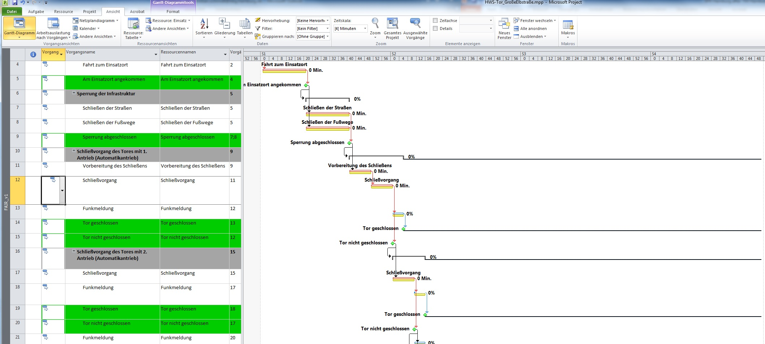
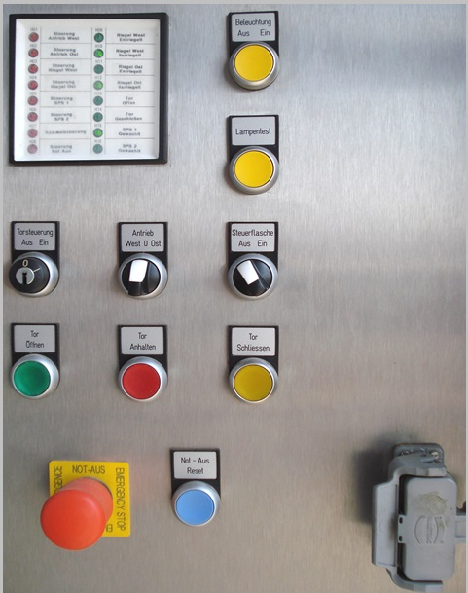
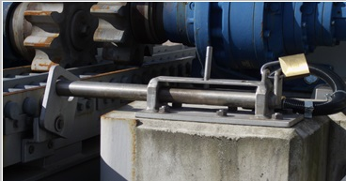
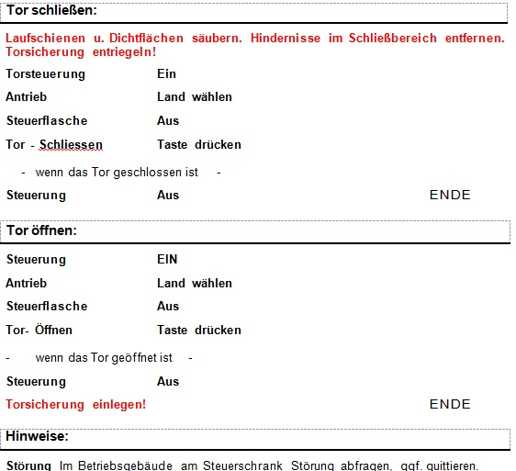
Crossing the gate ( gate not closed); 3,4,5,6,8

Slide 3
