Slide 1
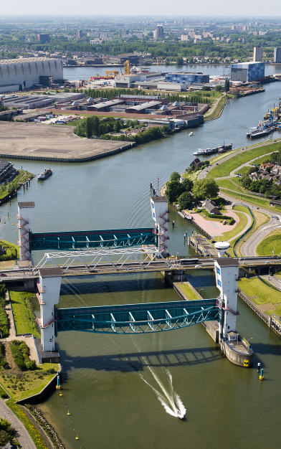
Asses further improvements of the HIJ barrier in relation to system of HIJ
Ina Konterman
Rijkswaterstaat
24th of September 2018
Notes:
Welcome, my name is Pim Neefjes and I will give you a brief introduction of The Deltaprogramma, with a short history, the challenges and choosen strategies.
Hollandsche IJsselkering. De Hollandsche IJsselkering beschermt het laagstgelegen deel van Nederland, 6,76 m onder NAP. Dit Deltawerk bij Krimpen aan den IJssel was als eerste van de 13 klaar. Rijkswaterstaat begon een jaar na de watersnoodramp (1953) met de bouw van de Hollandsche IJsselkering.

Slide 2
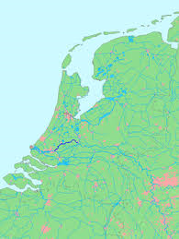
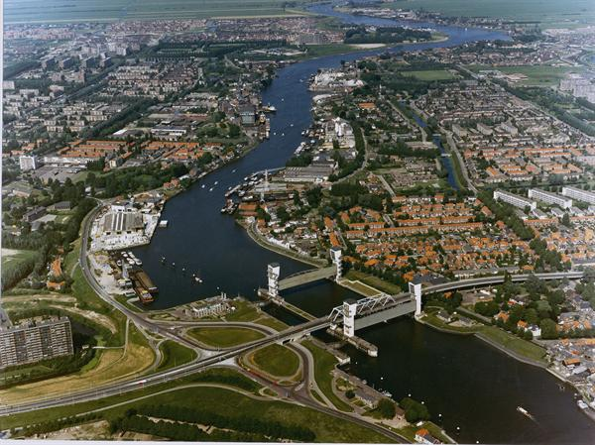
Hollandse IJssel

Slide 3
System analysis
SPR Framework

Slide 4
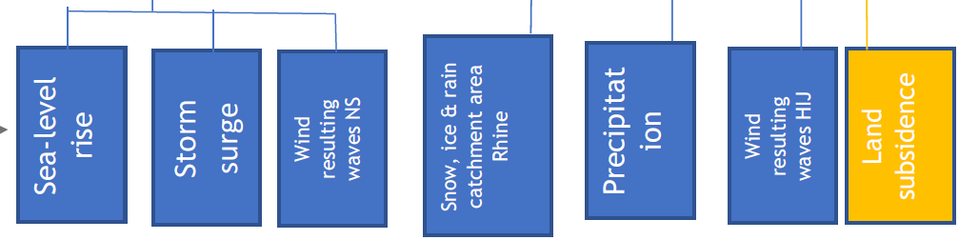
Sources (1)
Sealevel rise
Scenario’s used for sea-level rise
7 cm in 2015
35 cm in 2050
85 cm in 2100
River discharge
Use of Grade Model

Slide 5
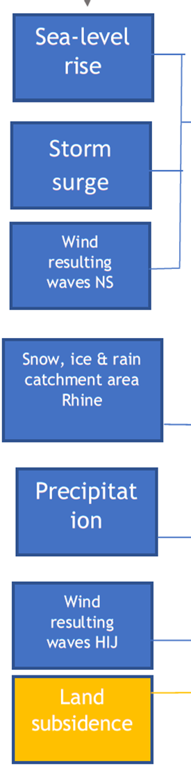
Sources (2)
Extreme storm surges
Strength of the storm, direction and timeline of the storm, and correlation with (volumes of) rain – more study is still needed!
Landsubsidence
1,1 cm / year in the Krimpenerwaard
2050: 33 cm
2100: 88 cm

Slide 6
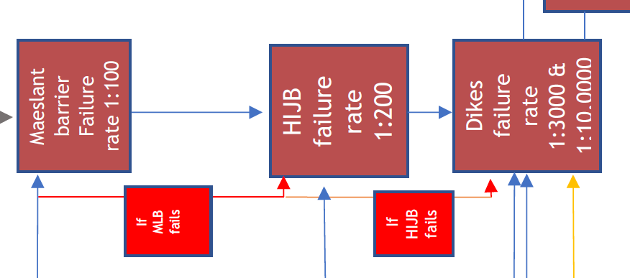

Pathway
Current failure probability HIJK and MLK
Failure probability Maeslantkering: 1 op 100
Failure probability Hollandsche IJsselkering: 1 op 200
Failure mechanisms of dikes (presentation KIJK)

Slide 7
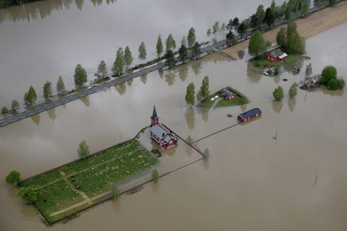
Receptors

Slide 8
Aim of protection against flooding
Approach Netherlands: Chance per person of dying due to flooding: 1x10⁻⁵ = once in 100.000 year
Based a/o on this, the norms of the dikes are designed )
Measures are needed for the Hollandsche IJssel to meet the norms (1:3.000 and 1:10.000)

Slide 9
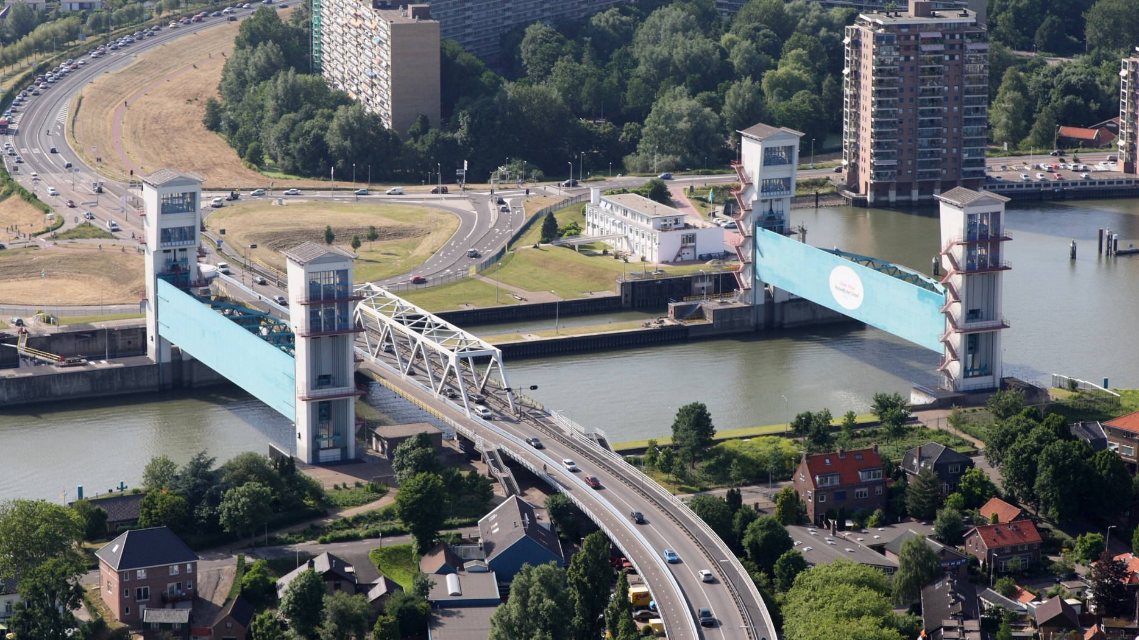
Three new measures are studied, besides dikes
Reduction of the failure rate of the SSB Hollandsche IJssel:
1: 200, 1: 1000 and 1: 5000 per closure

Slide 10
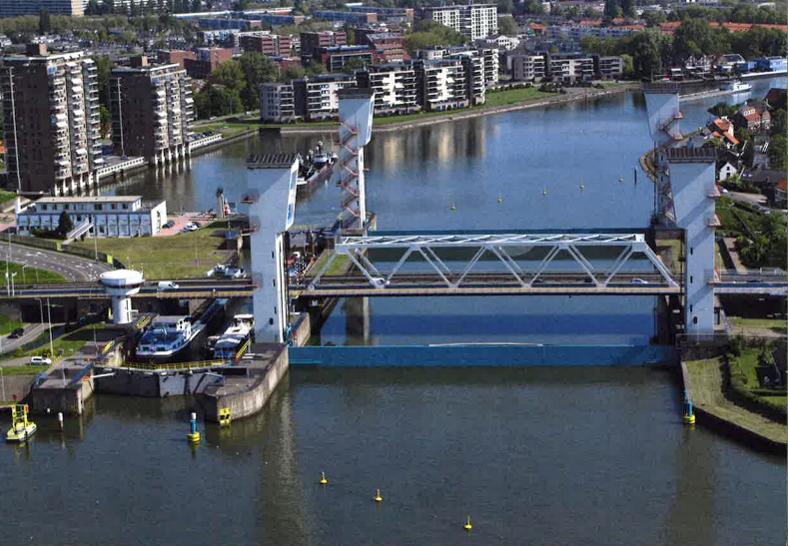
Three new measures are studied beside dikes
2. Closing the barrier at low tide at the point of reversing current instead of just before high water

Slide 11
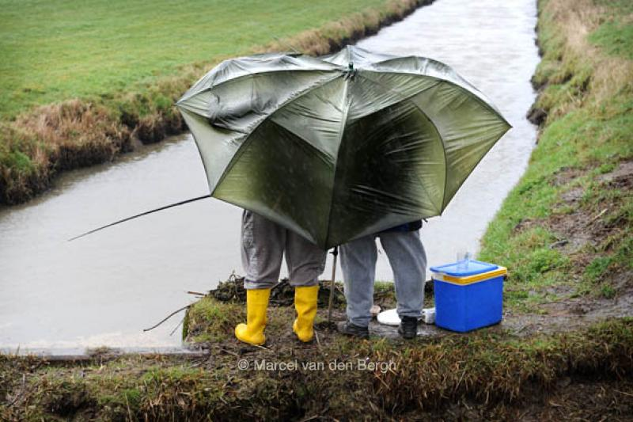
Three new measures are studied besides dikes
3. Limit the volume of water that enters the Hollandsche IJssel from the regional system as much as possible during cricial conditions

Slide 12
New measures for cost-effective protection of the area
Three types of system measures are studied:
Reduction of the failure rate of the SSB Hollandsche IJssel:
calculations for a failure rate of 1: 200, 1: 1000 and 1: 5000 per closure
2. Closing the barrier at low tide at the point of reversing current instead of just before high water
3. Limit the volume of water that enters the Hollandsche IJssel from the regional system if possible

Slide 13
Results of calculations – T = 3000, climate scenario 2015
0
1
1+2
1+2+3

Slide 14
Results of calculations – T = 3000, climate scenario 2015
0
1
1+2
1+2+3

Slide 15
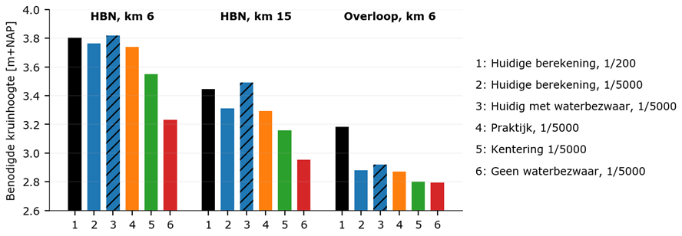
Further analysis
Impact of measures on the height of the dikes
0
1+2+3

Slide 16
Conclusions
Especially a combination of three measures has a substantial impact on the water level.
The impact varies along the river, they result in a reduction of waterlevel of approximately 45 to 70 cm.
Regarding the impact on the height of the dikes: the impact is less because of the influence of storms
With climate change (in 2050 and 2100), the impact of the measures is less
With a more reliable storm surge barrier, the impact of failing dikes on the hinterland is less serious

Slide 17
Next steps
  Next steps system analysis
Reproduction of the results with a better hydraulic model (approved by the government)
Study correlation of storm and rain. And study the volume of regional water that is expected to flow into the Hollandsche IJssel during critical conditions
Issue of ‘model insecurity’ needs to be solved
Improvements HIJK have been studied - a/o impact on operation and maintenance
Cost assessments of all measures
Conclusions: most cost-effective way to protect area in the long run

